Slide 1
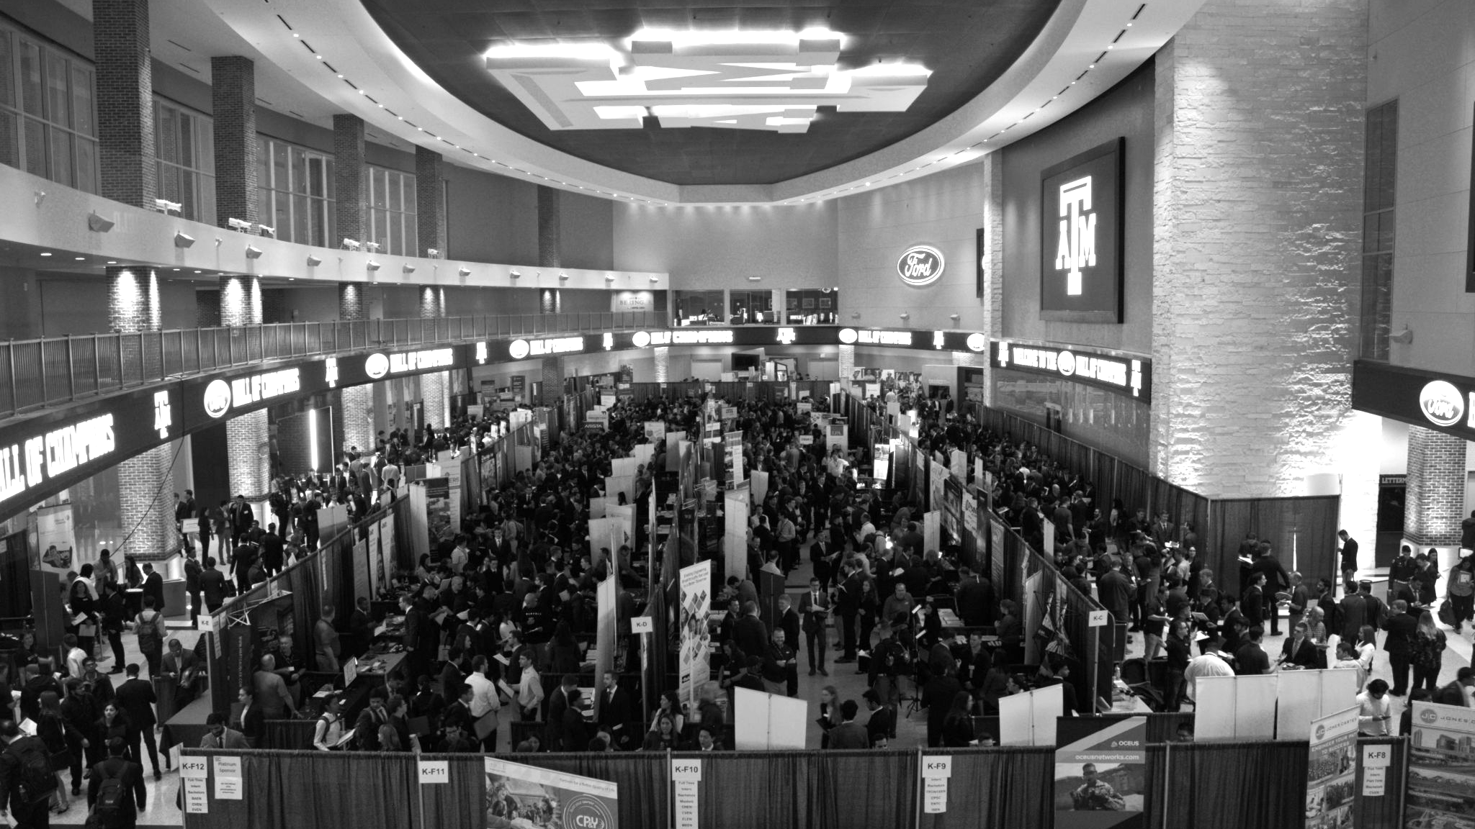

LANL Team Project Update
2/19/2025
Izzy Baumler, Dalton Boeckmann, Morgan Gullo, Jade Waldron

Slide 2
Problem Statement/Project Motivation
There is a need for a technology that has 5 DOF and can move through its full range of motion in each degree of freedom of at least 1 Hz.

Slide 3
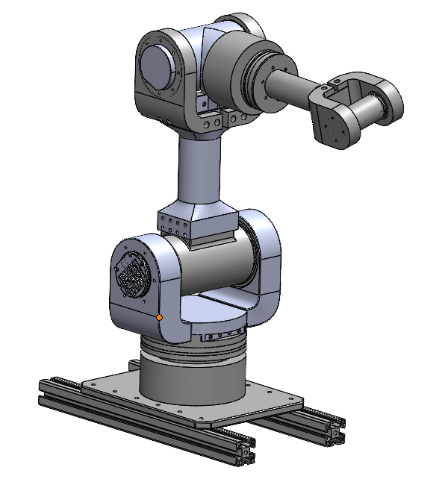
Weekly Assigned Tasks
Jade - Solidworks Refinement/Prototyping/Assembly
Izzy - Motor Research and testing
Dalton - Assembly/Motor Testing
Morgan - Purchase Orders/Electrical

Slide 4
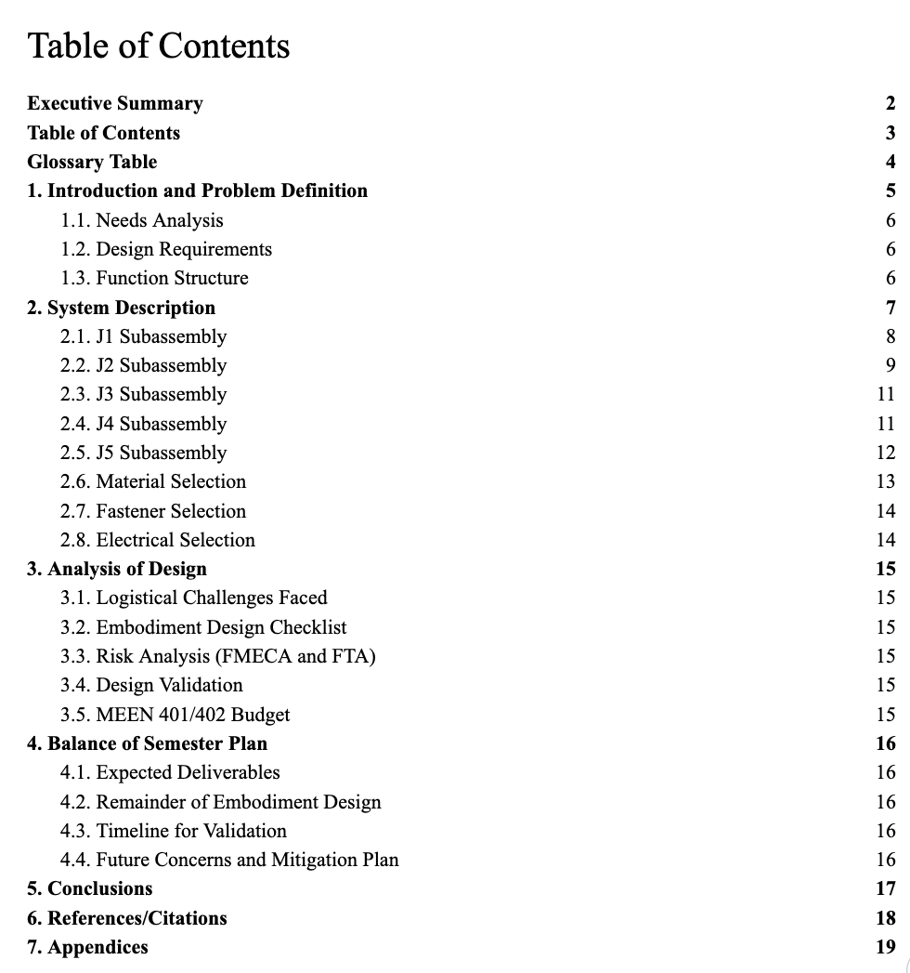
Midterm Report Update
15% Professionalism and Presentation
10% Executive Summary
10% Introduction and Problem Definition
20% System Description
25% Analysis of Design
15% Balance of Semester Plan
5% Conclusion

Slide 5
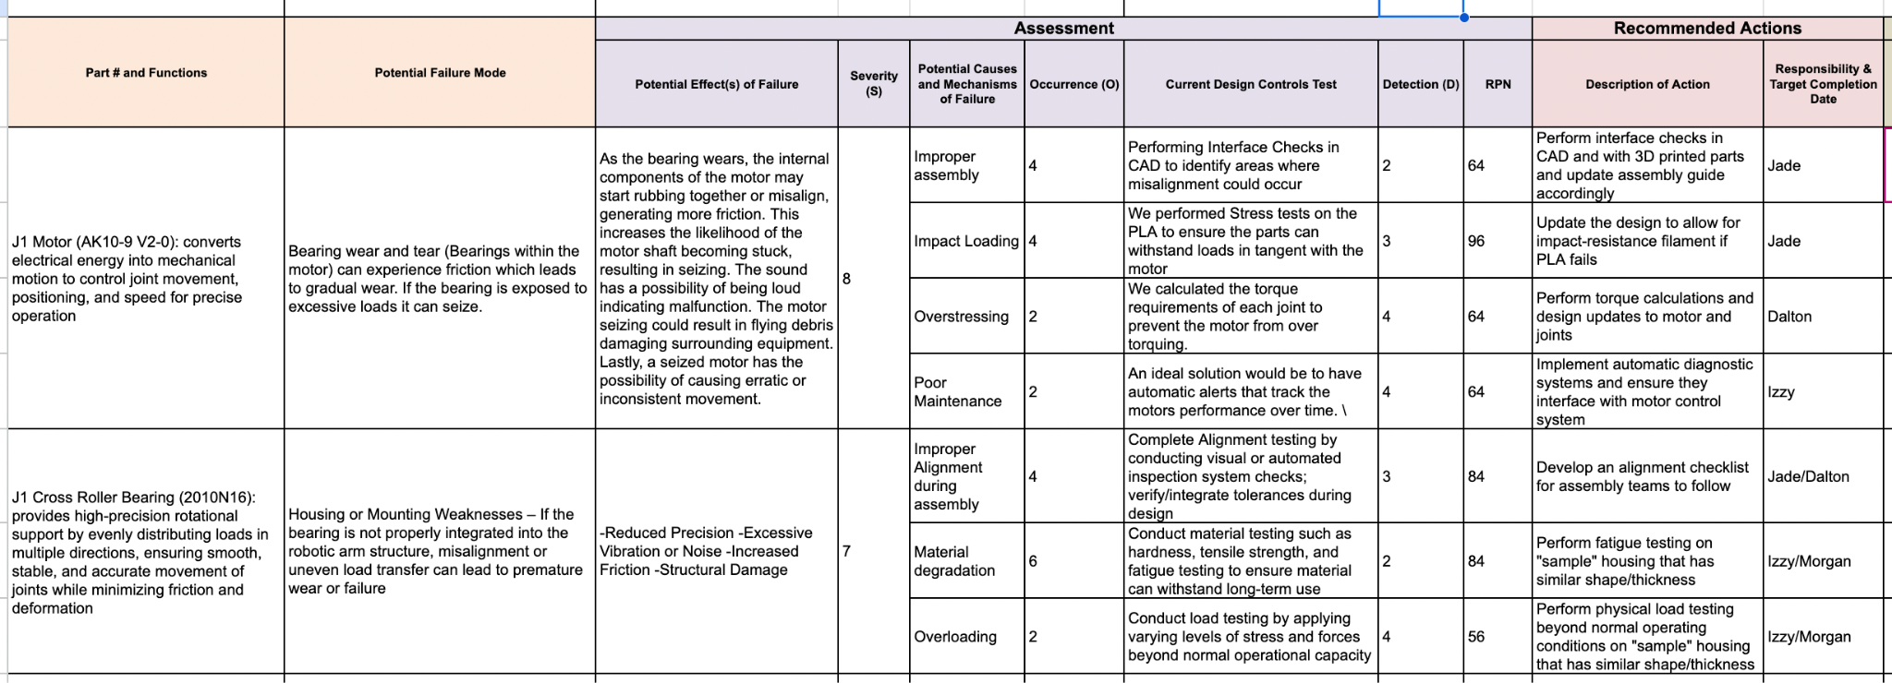
FMEA

Slide 6
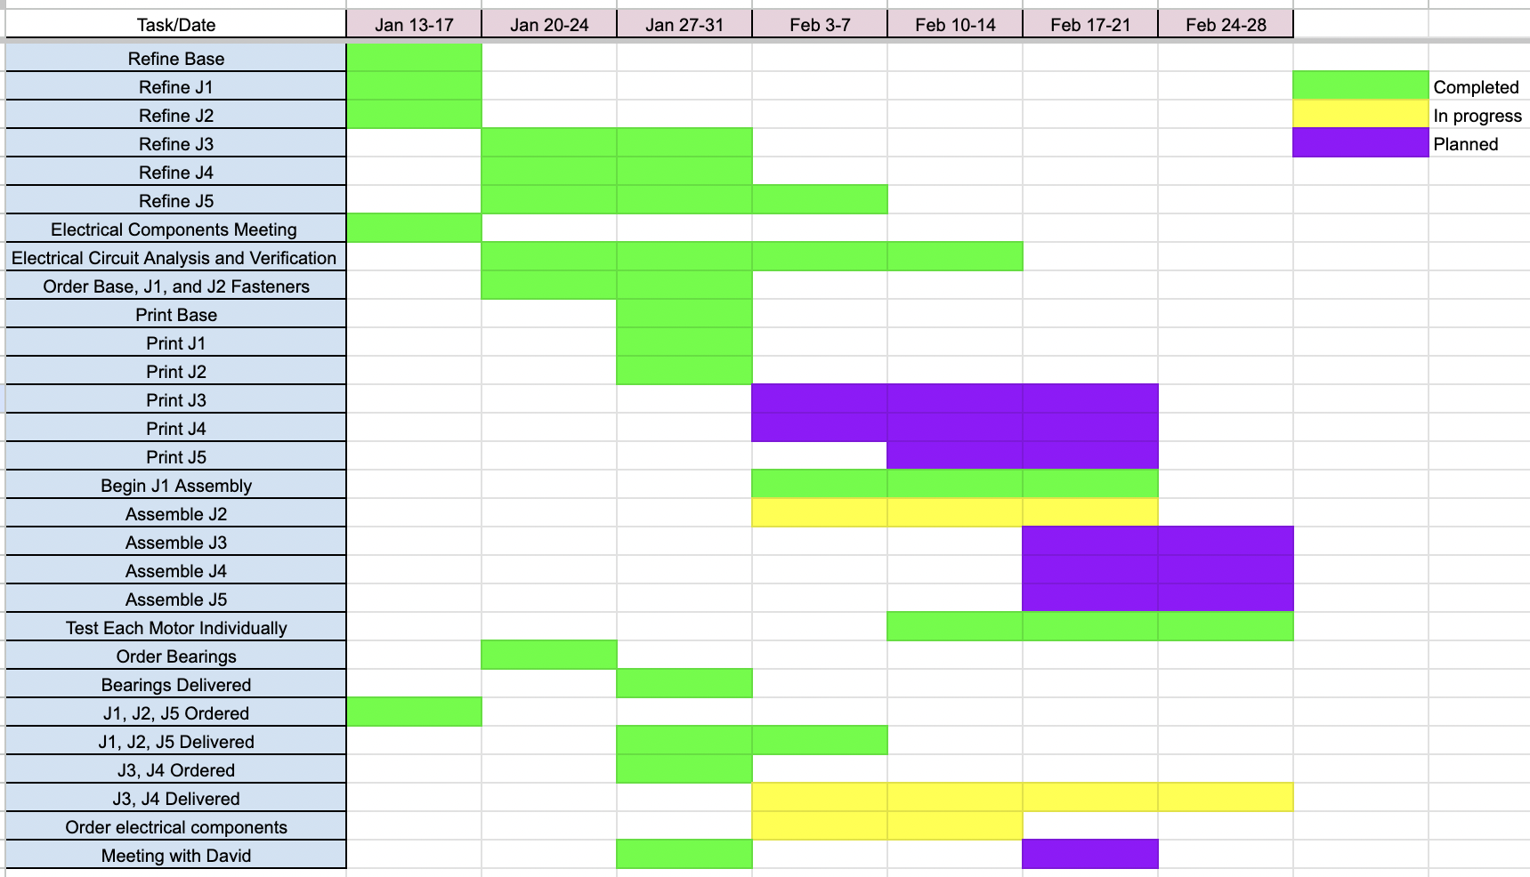
Schedule Update

Slide 7
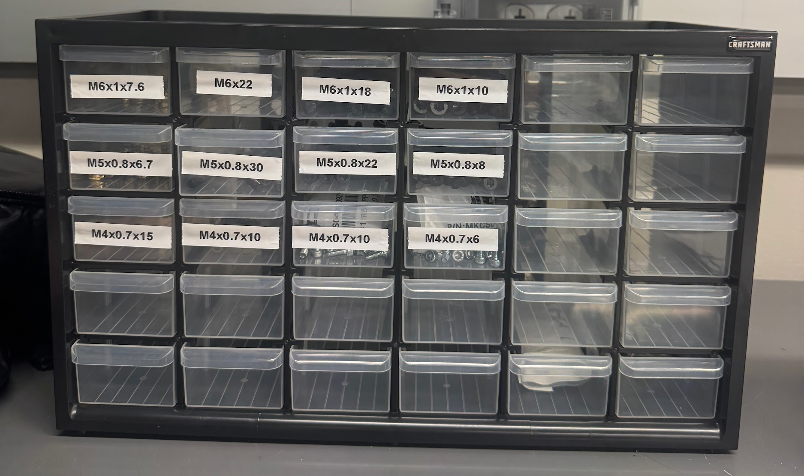
Fasteners
Verification of Fasteners for J1/J2
All Fasteners for the Robot are allocated, plan to order sometime next week after we finish assembling J1 and J2
Morgan organized these fasteners with our organization kit

Slide 8
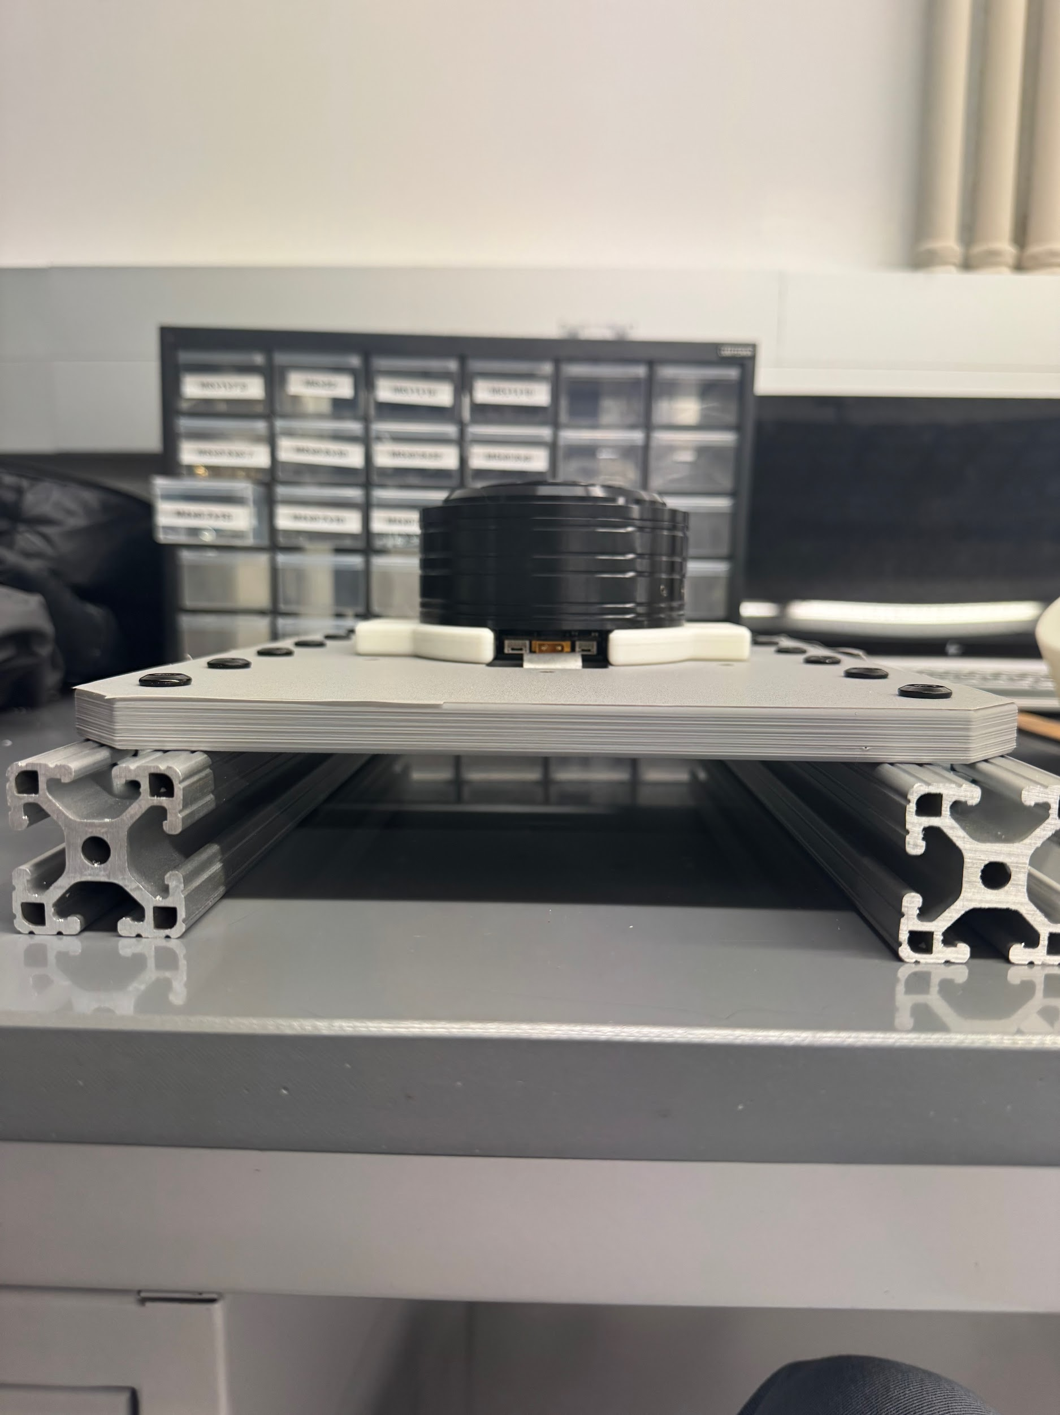
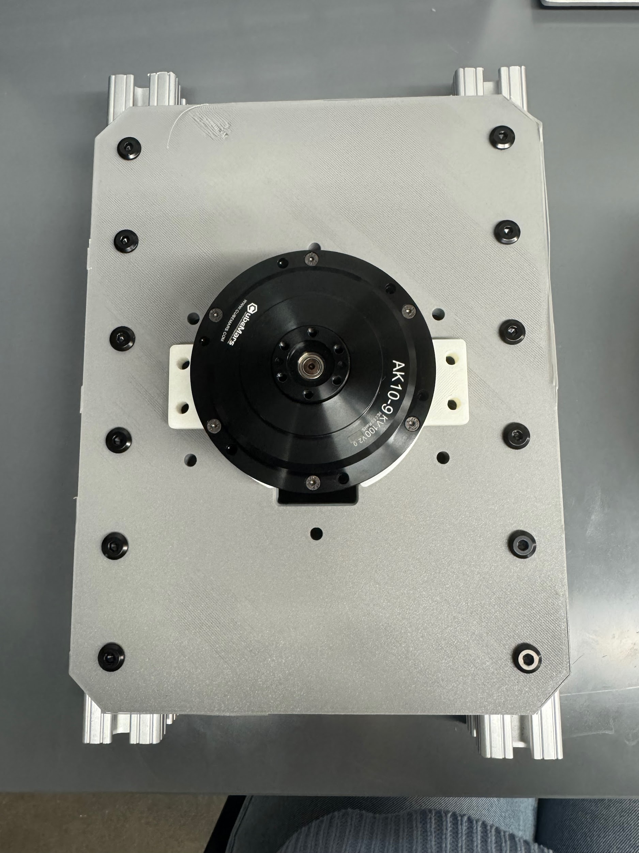
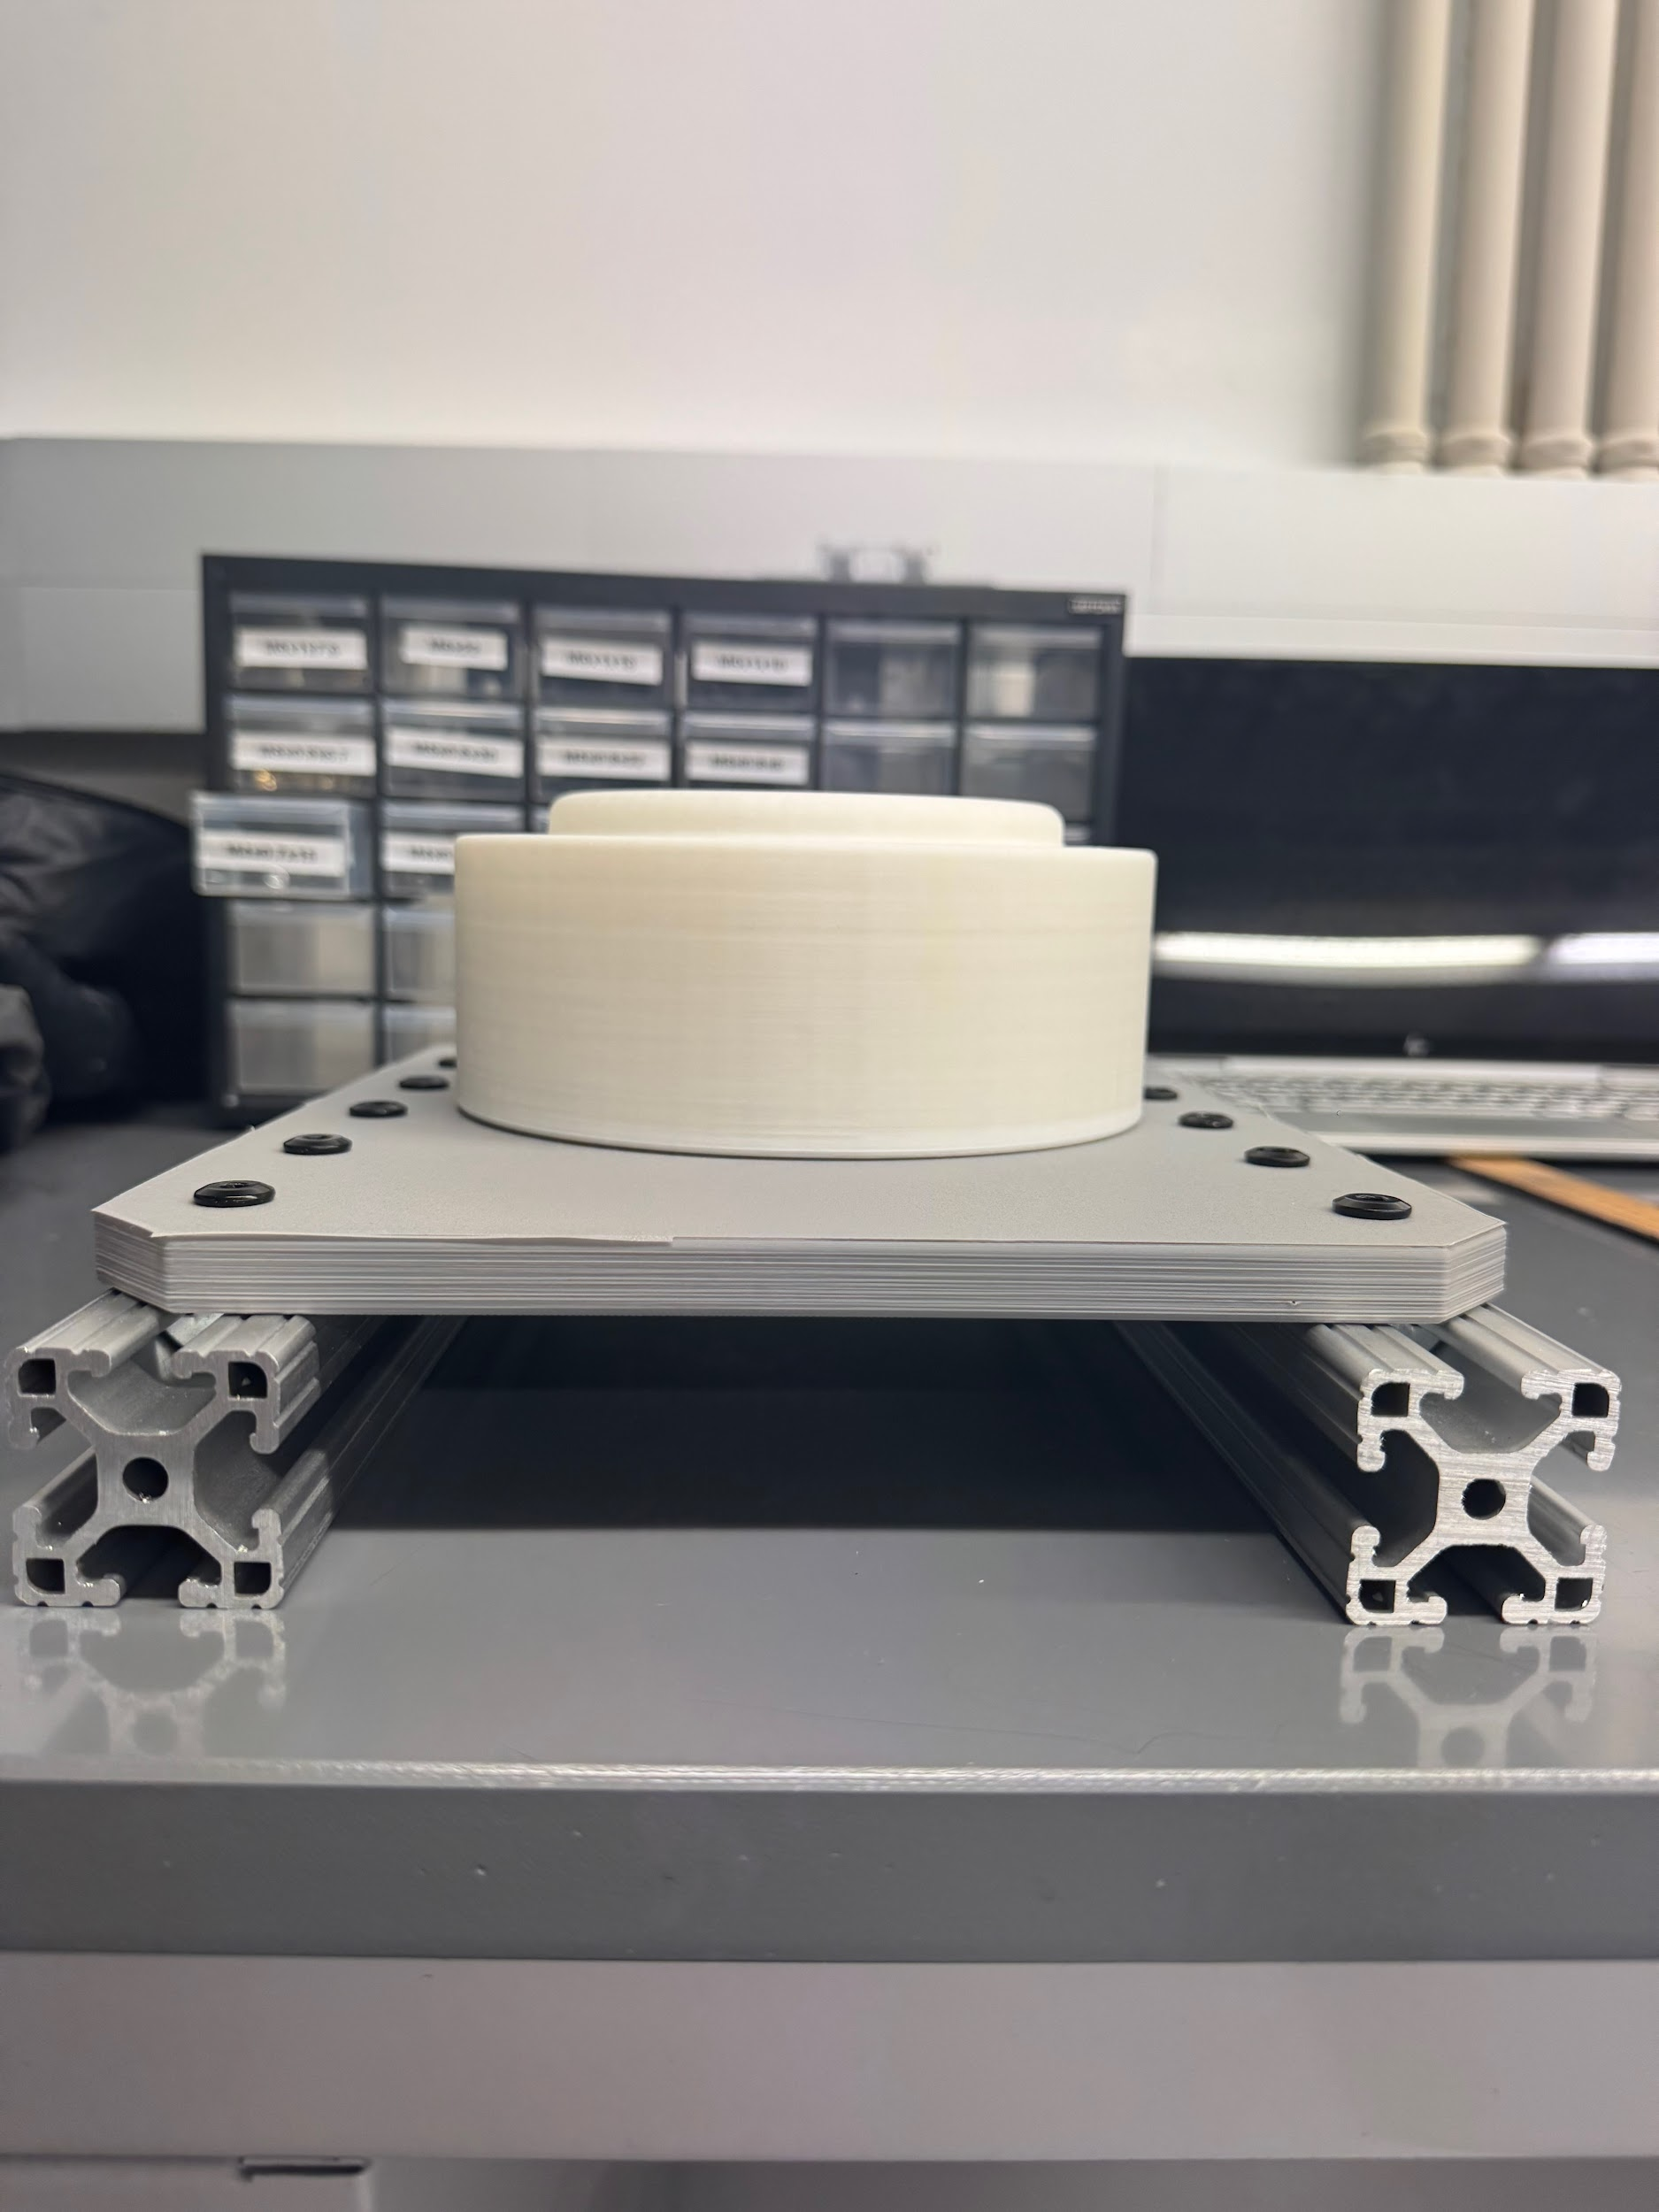
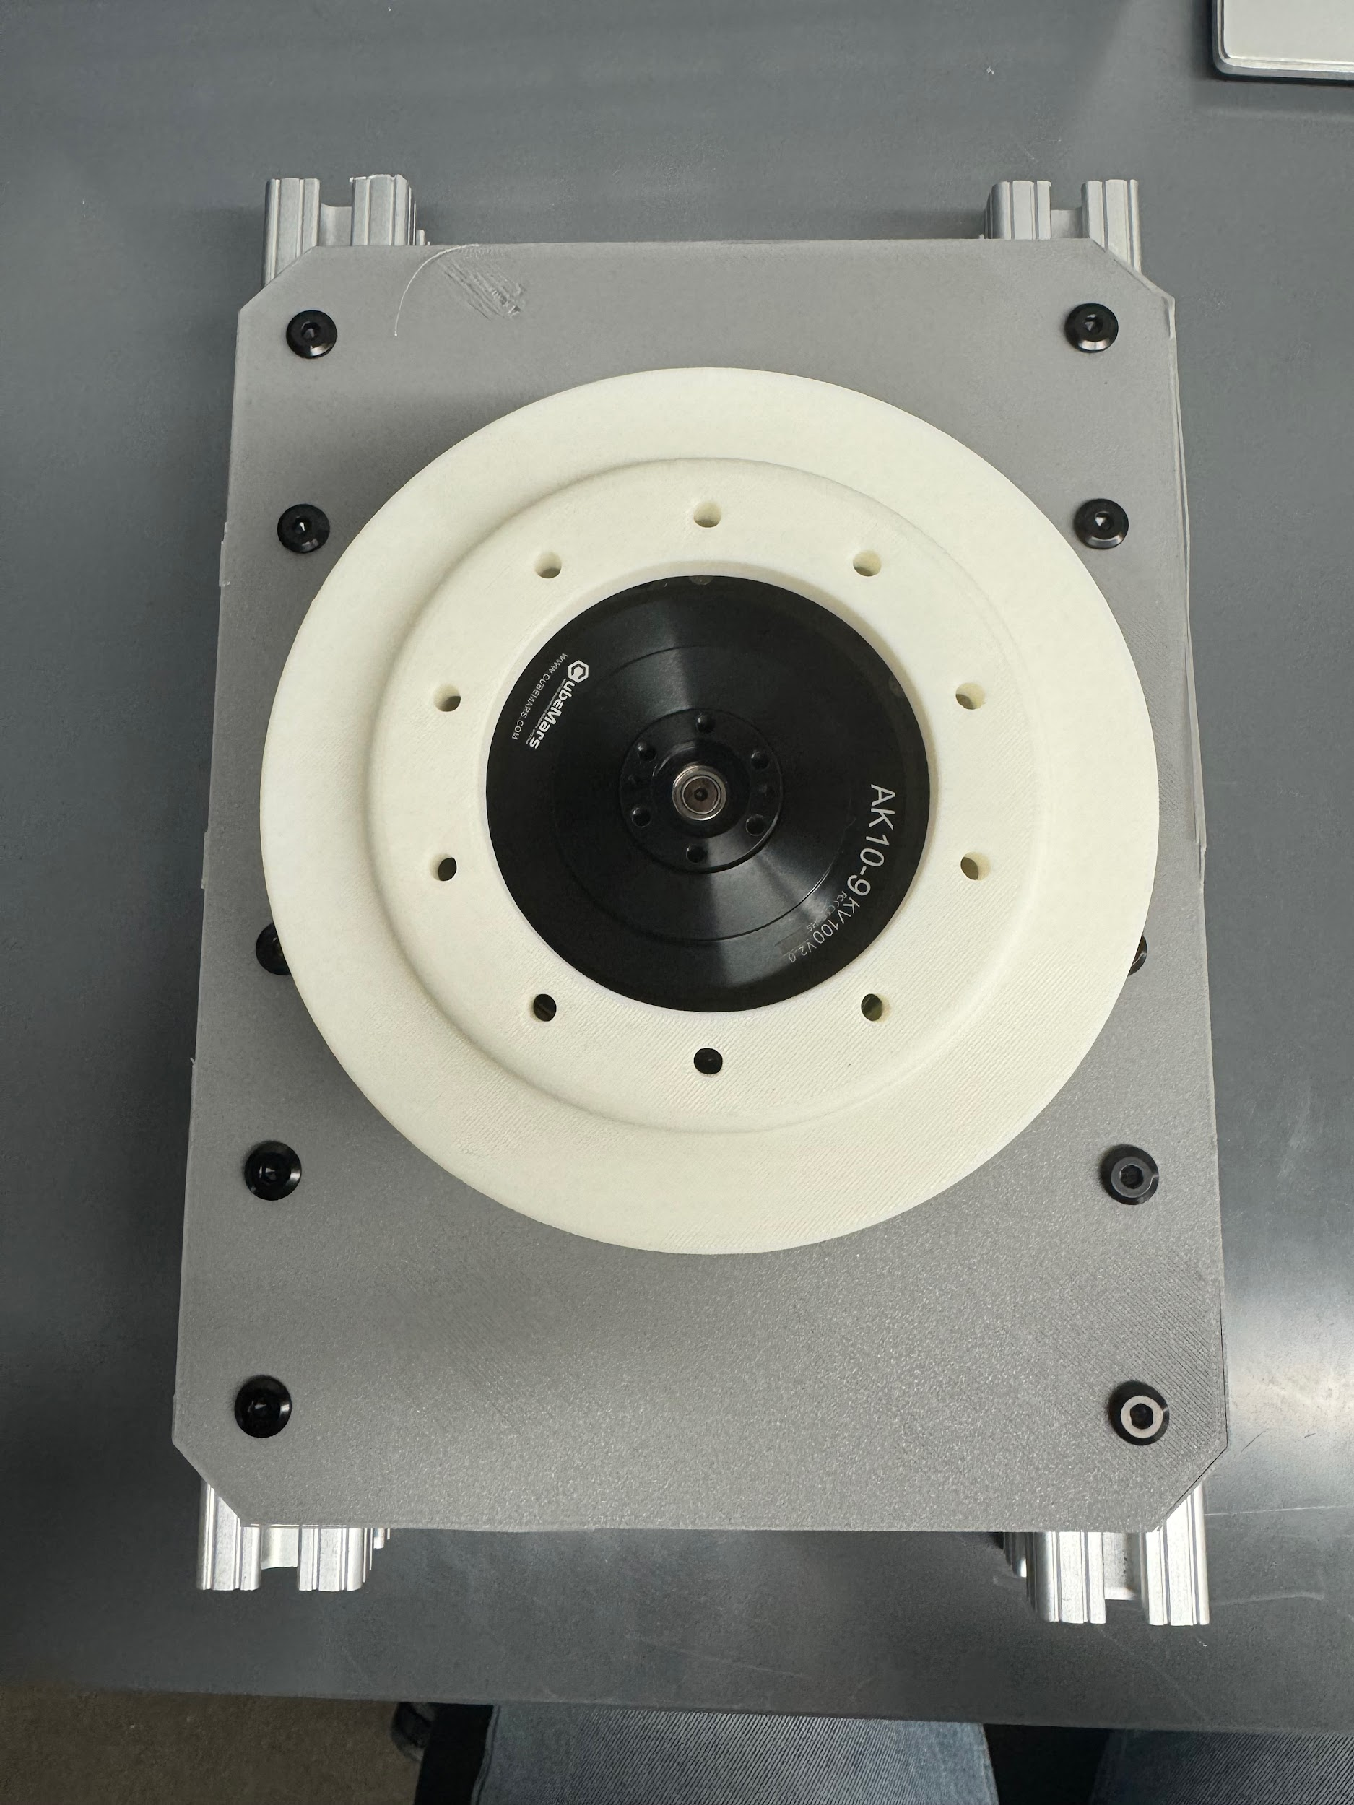
Prototyping/Assembly

Slide 9
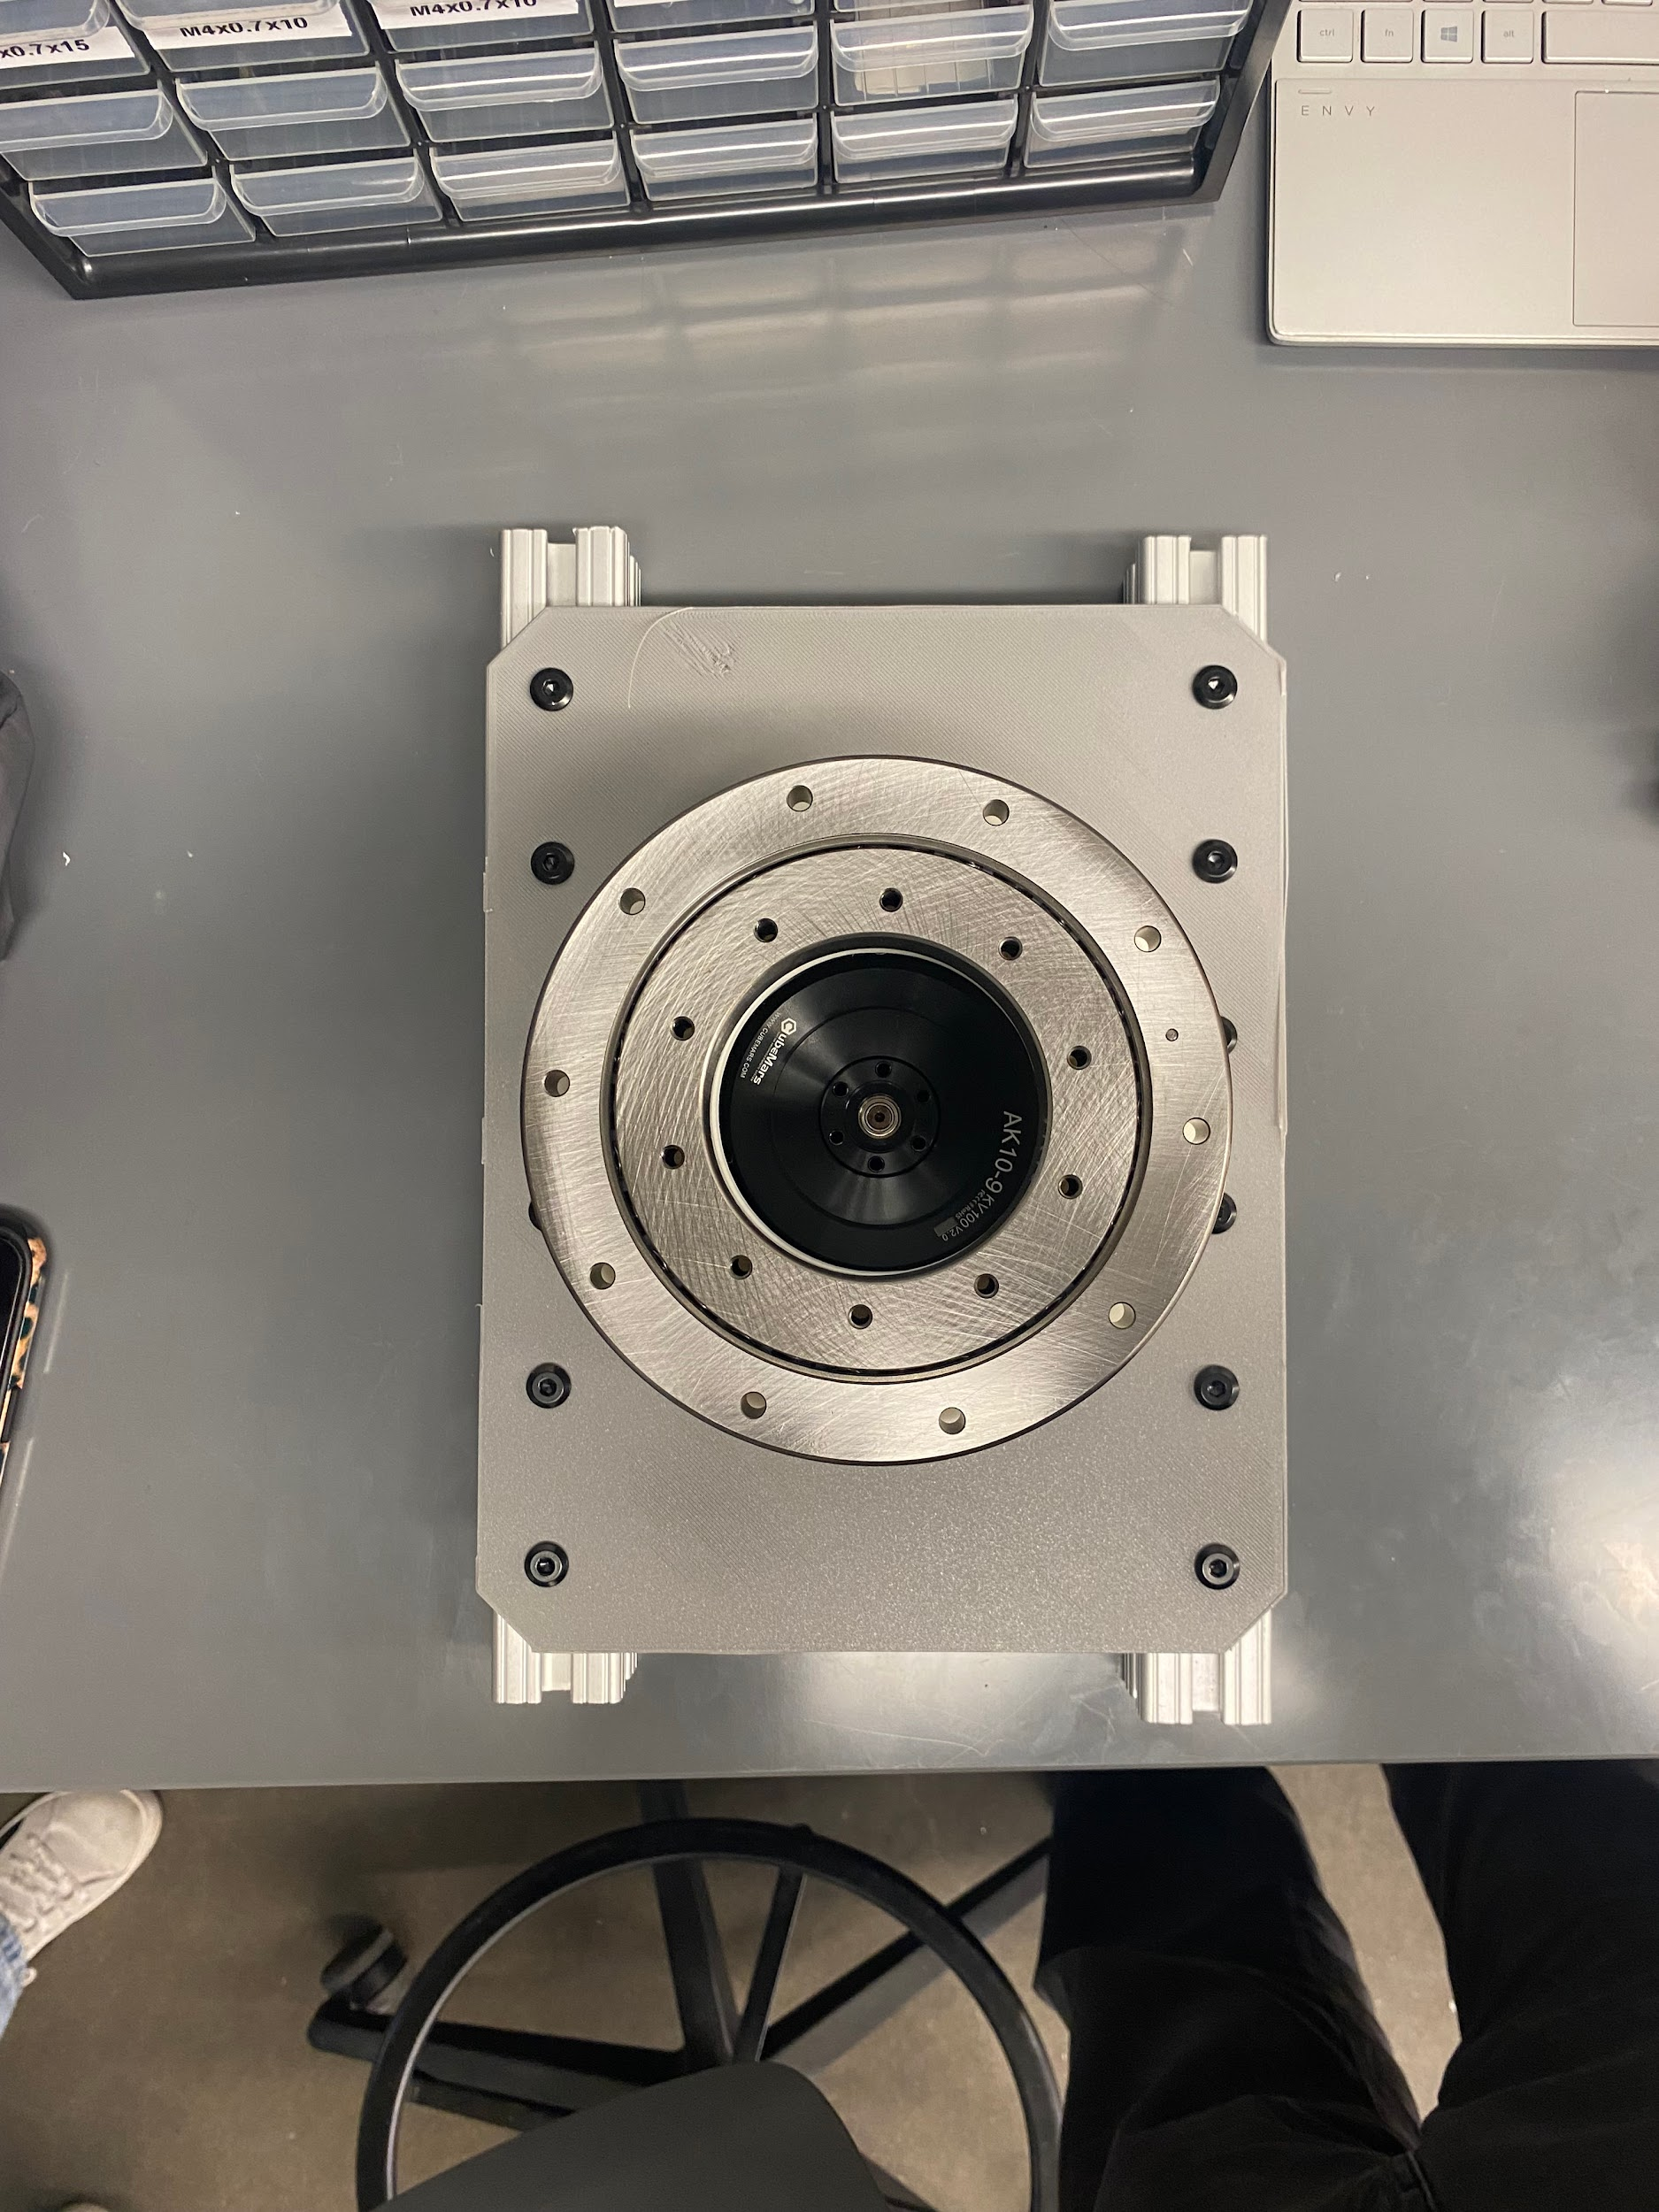
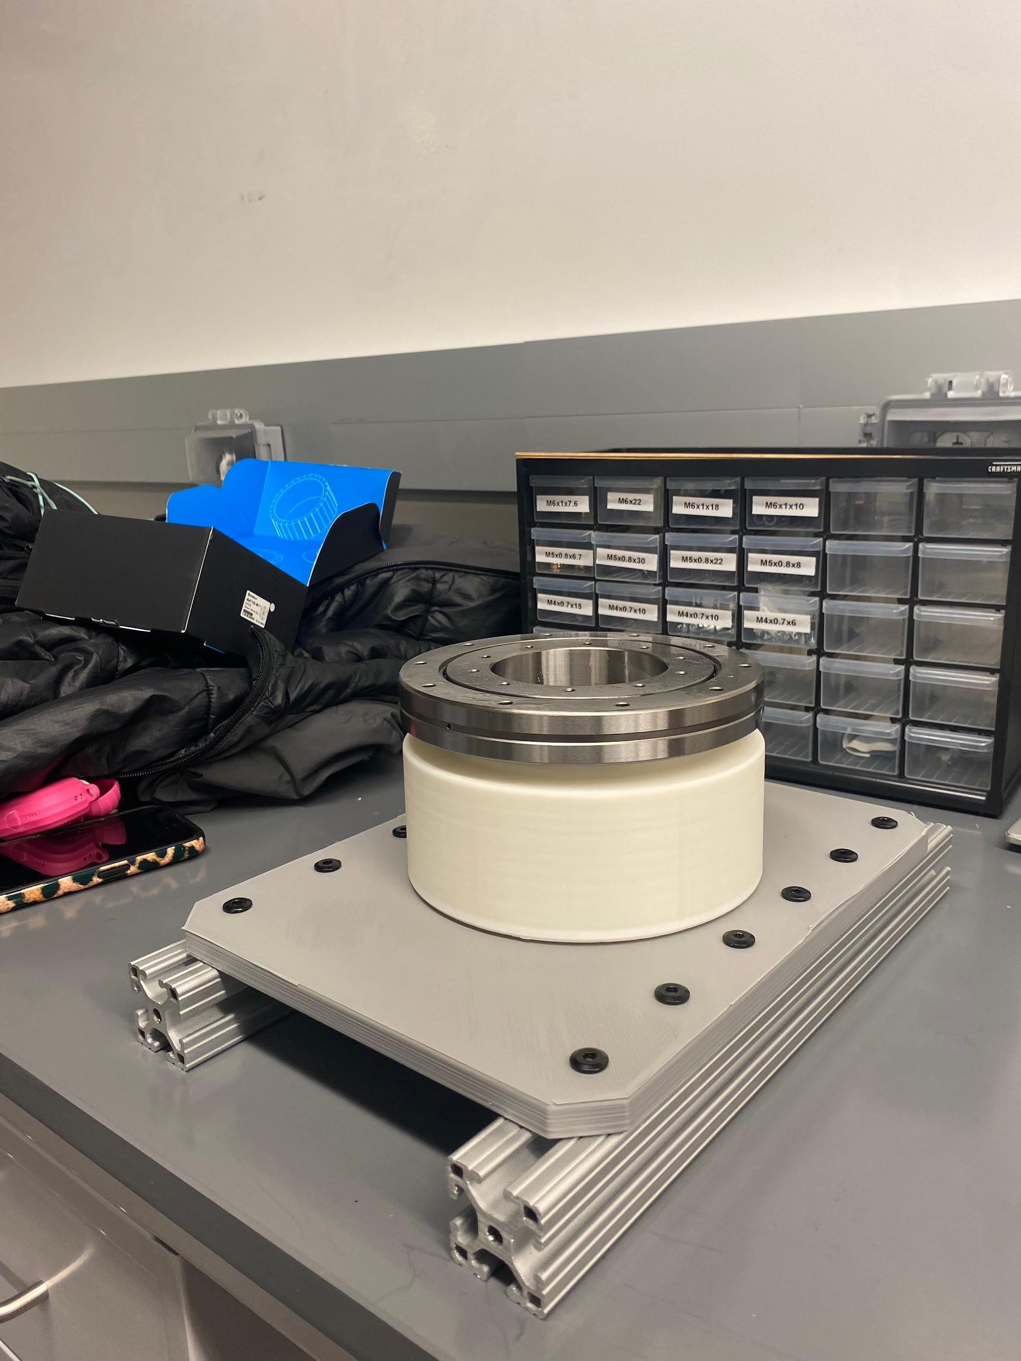
Prototyping/Assembly

Slide 10
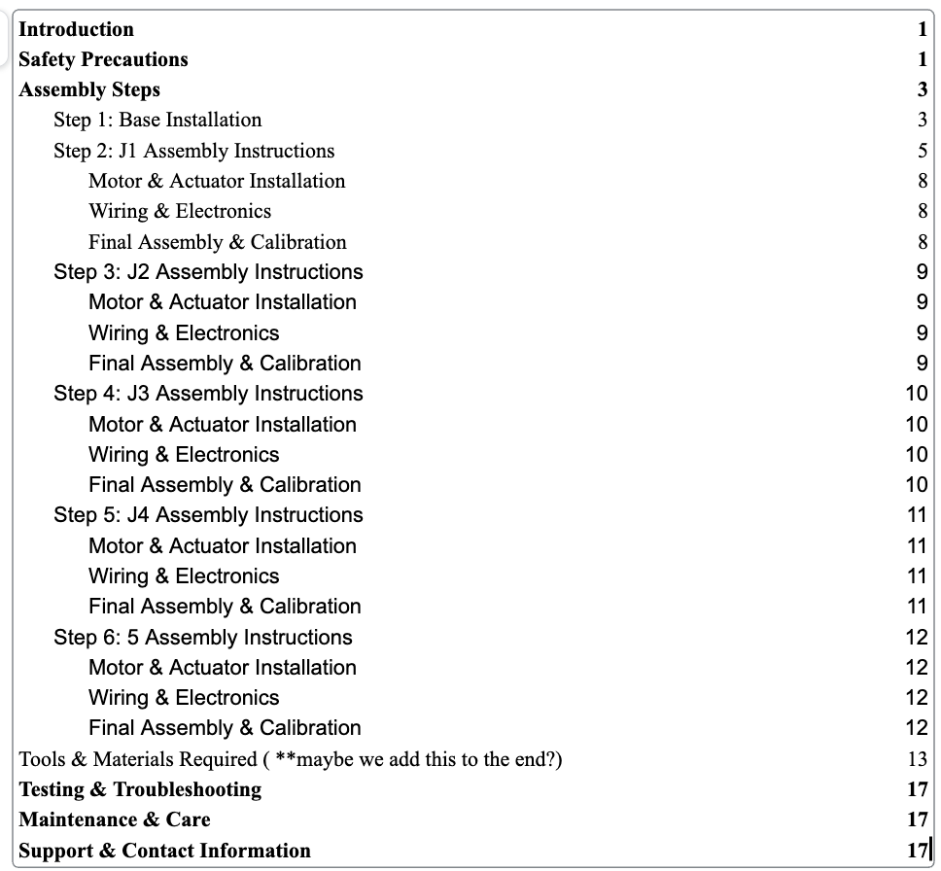
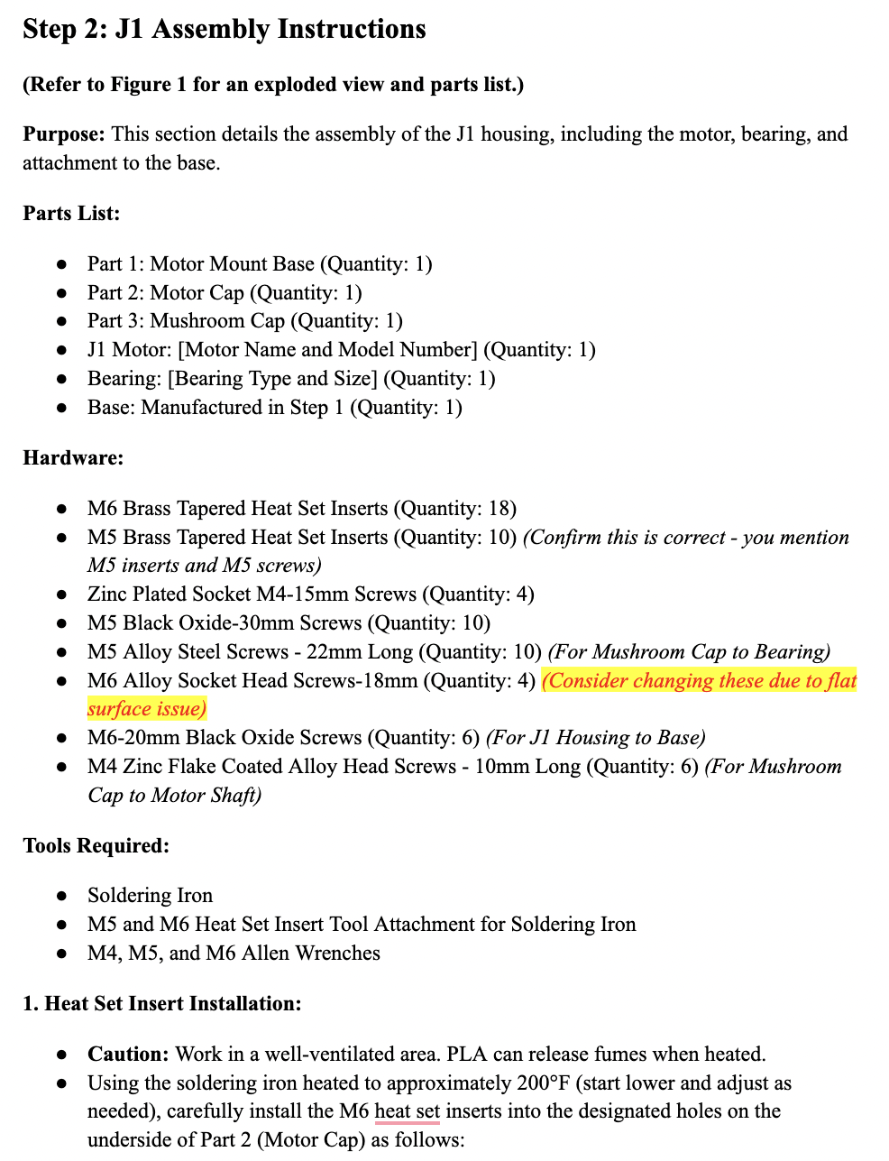
Assembly Manual

Slide 11
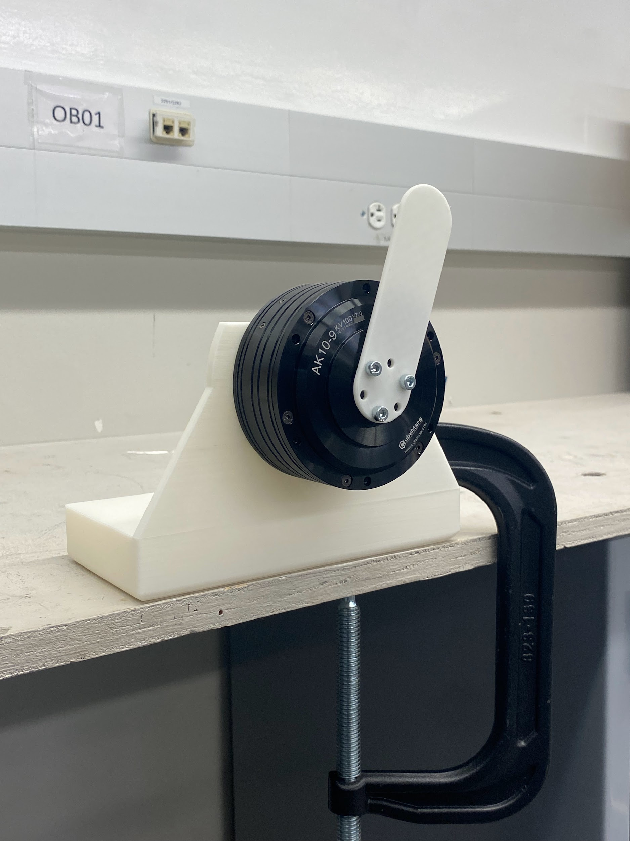
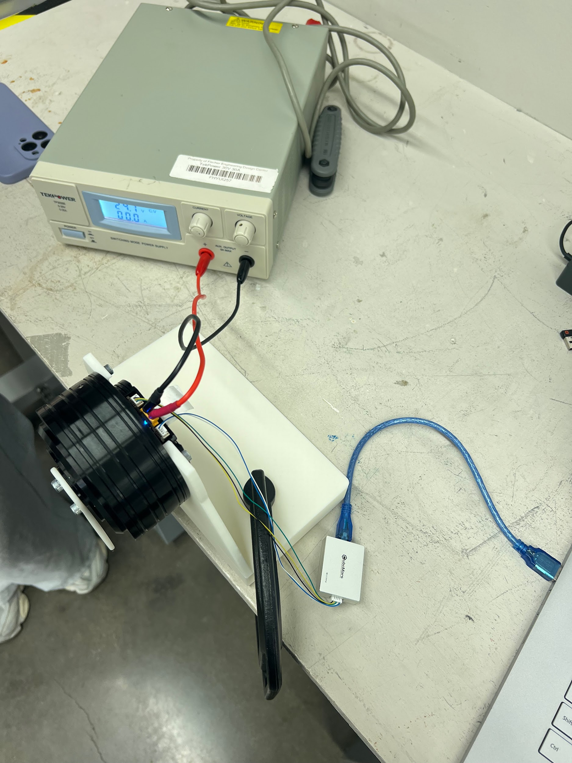
Motor Research/Testing
Utilized a CubeMars device called “R-Link”
This device allows us to connect to the Upper Computer software that comes with the motors
Tested setting the position (Rad), Speed (Rad/s), Kp, and Kd values of the motor

Slide 12
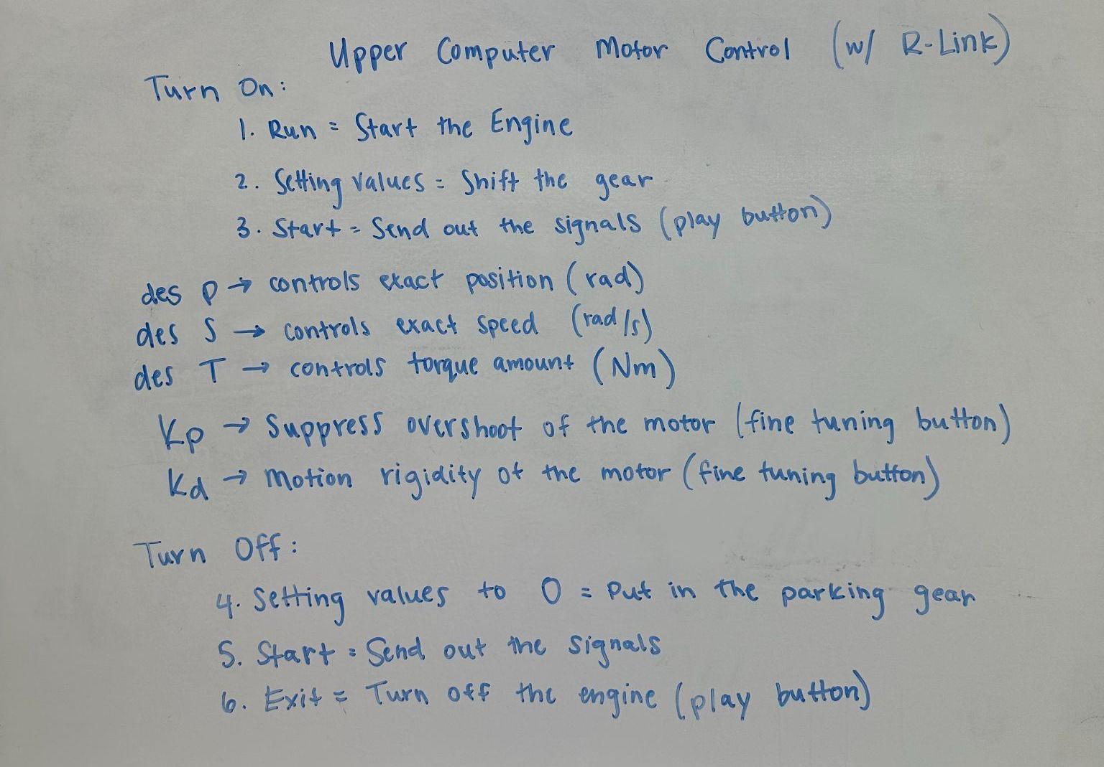
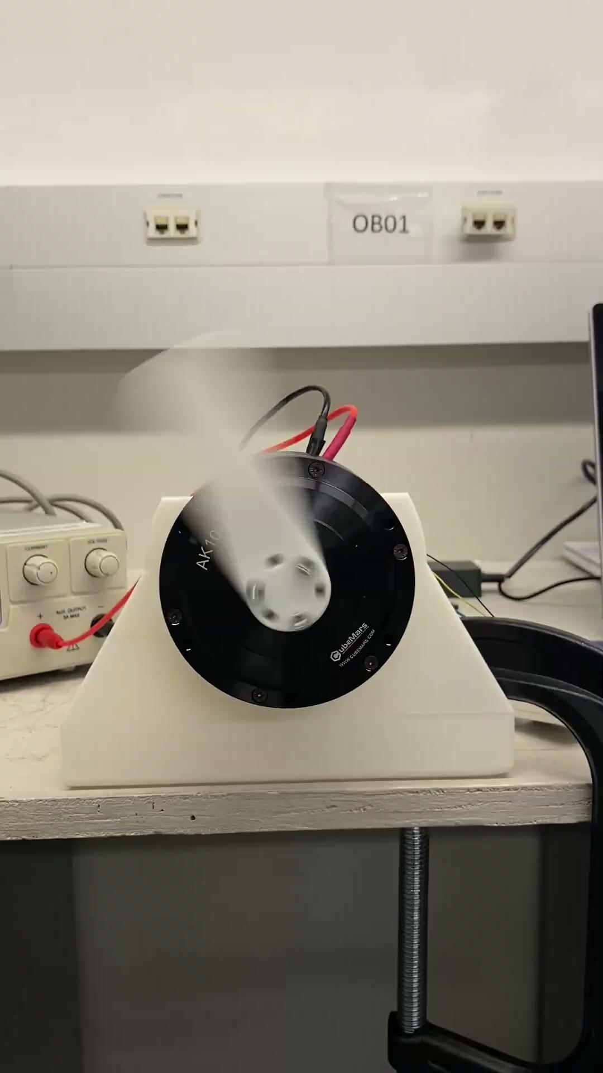
Motor Research/Testing
*Torque set to 4 Nm

Slide 13
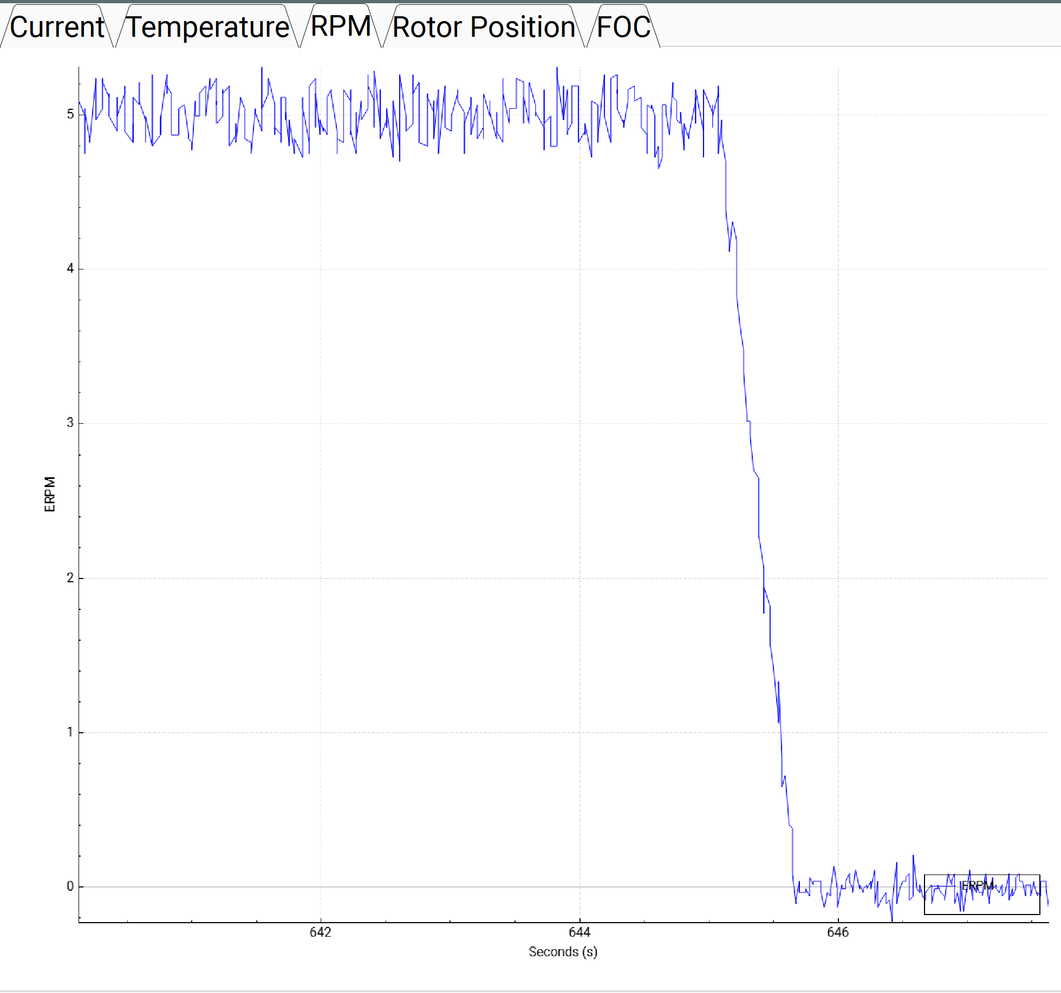
Motor Data
Recorded data from the Upper Computer Software
This is from testing the Torque set to 4 Nm
ERPM vs Time (s)

Slide 14
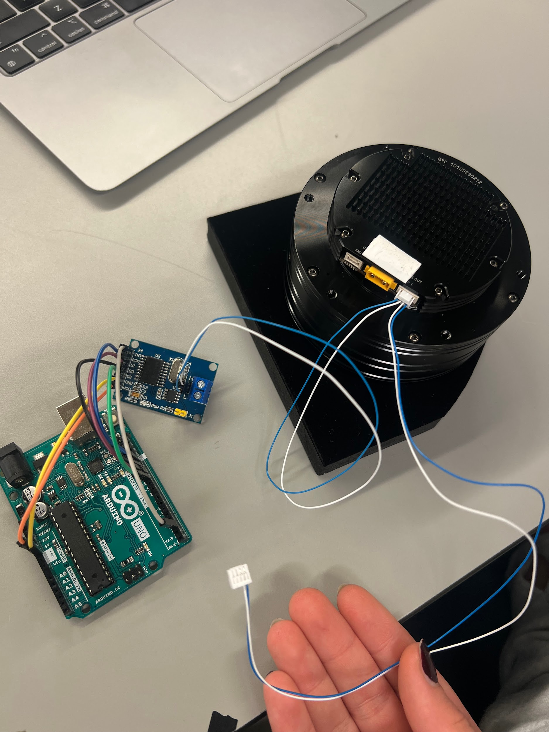
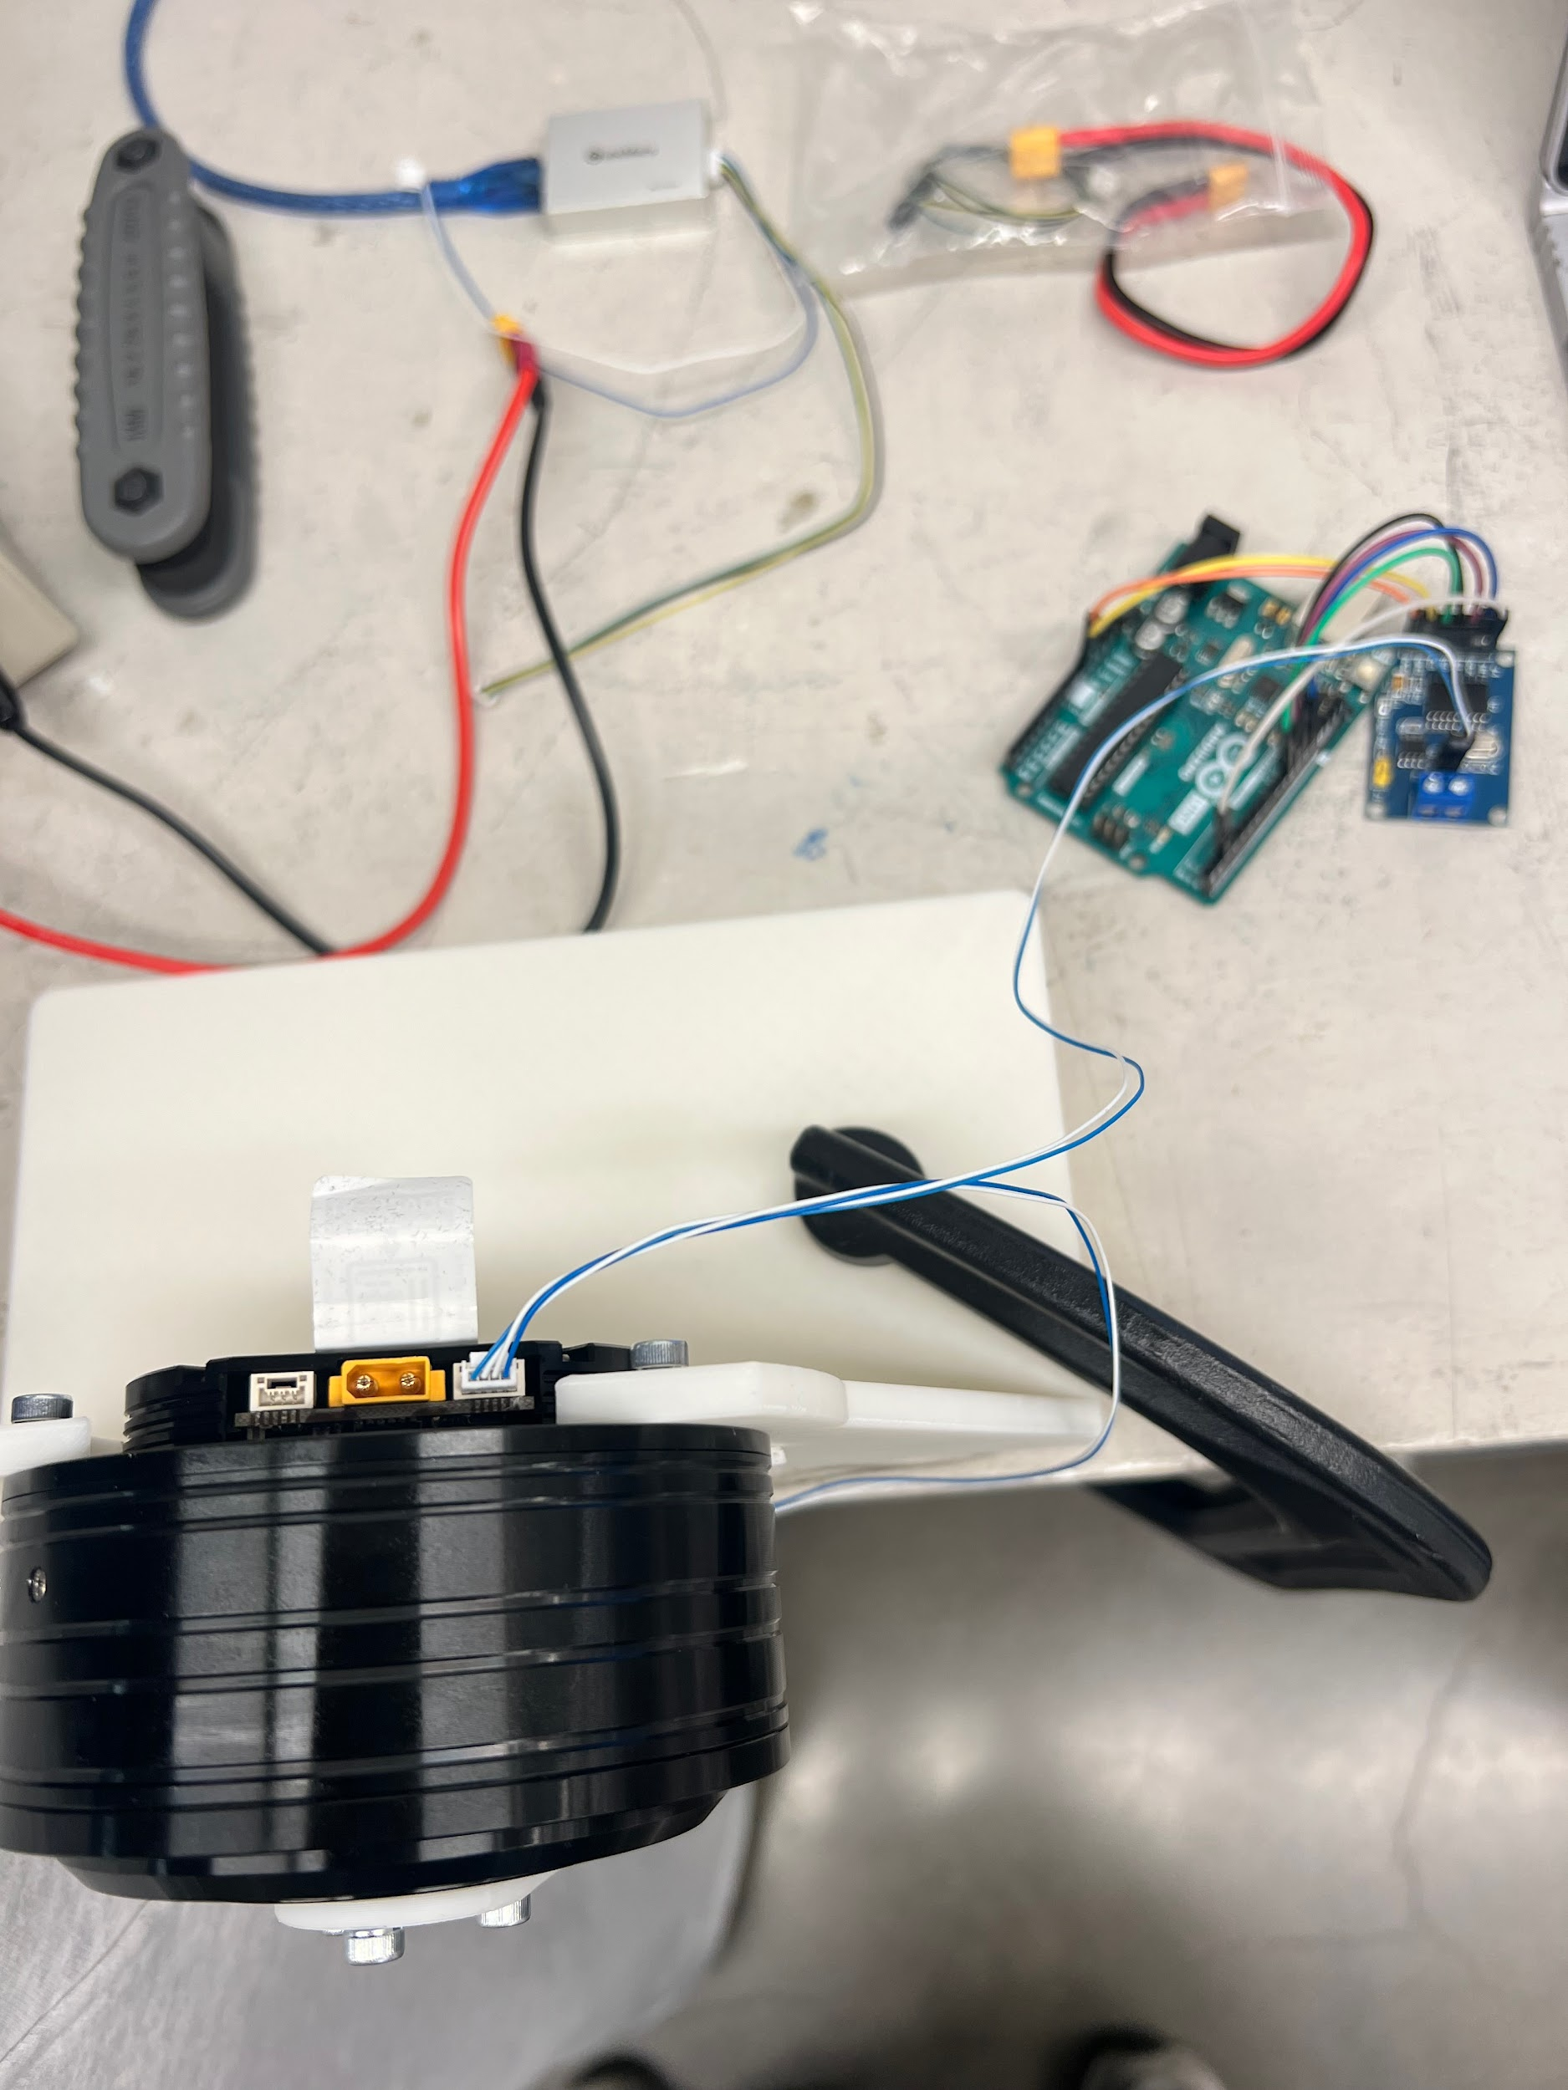
Motor Controls
Working on Can Bus MCP2515 to Arduino Uno Connection
Reaching out to Professor Gray Thomas for help
Confirmed motor and Arduino operate correctly so next step is to troubleshoot the Can Bus

Slide 15
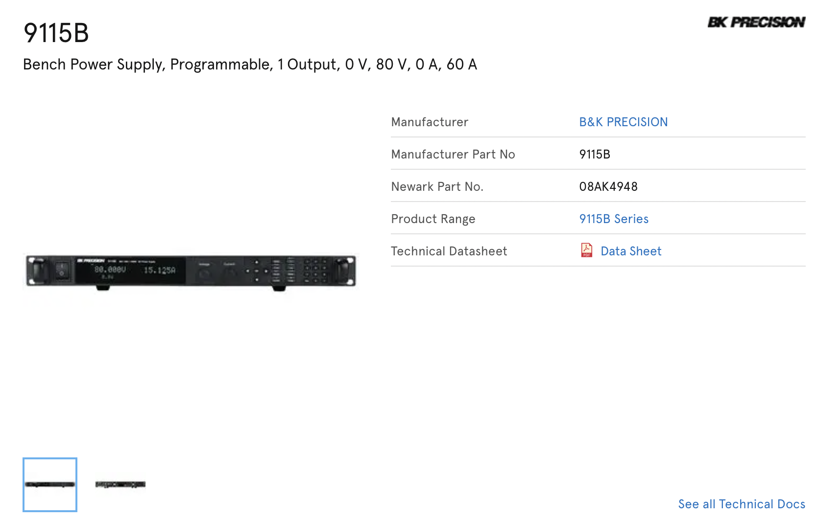
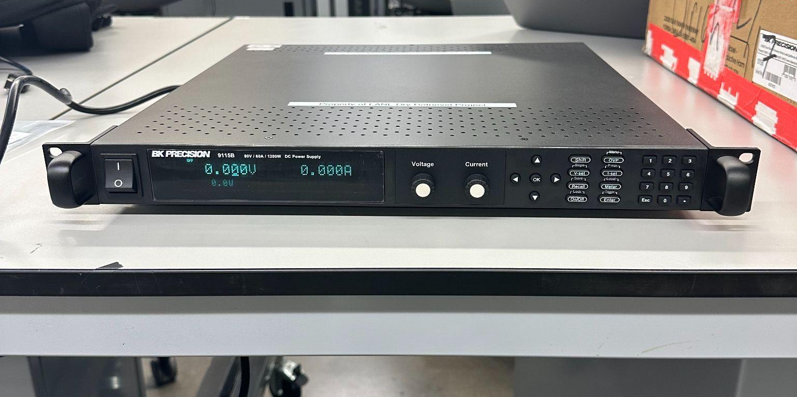
Motor Research/Testing

Slide 16
Future Work
Order/Verify electrical components
Continue assembling Base, J1, and J2
Print J3, J4, and J5
Continue Assembly Manual
Continue working on midterm report/presentation
Meeting with David 02/21 @ 2:00pm

